Slide 1
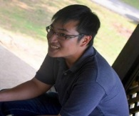
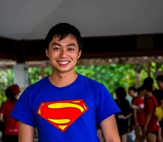
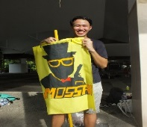
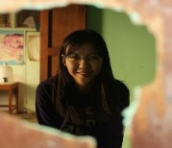
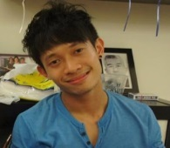
G1T3
Final Presentation
Kevin Onggo (PM)
Kong Yu Ning
Nicholas Lee
Nyein Su Aye
Zachery Pang

Slide 2
Scope of Presentation
Schedule
Metrics
Use of Subversion
Others

Slide 3
Schedule
1
Actual Vs Planned
2
Functionalities & Frameworks
3
Task Distribution
4
Task Allocation
5
Programming Hours
6
Problems Faced

Slide 4
1
Actual vs Planned
A: 19
P: 20
A: 13
P: 13
A: 13
P: 13
A: 11
P: 11
A: 7
P: 7
A: 7
P: 7
Week 3-4
Week 5-6
Week 8-10
Week 11-12
Week 13
Notes:
Explain the deviation, and more importantly why our schedule doesn’t have a regular chunk like 2 weeks.

Slide 5
1
Actual vs Planned
Week 3-4
Week 7
Week 11-12
Iteration 1
1) Schedule Planning
2) Design & Diagram
3) Test Plan
Iteration 3
1) CRUD Functions
2) JSON Response
3) Basic UI
4) Supervisor Meeting*
Iteration 5
1) Internal UAT
2) Supervisor Meeting*
3) Improvements
4) UAT*
5) Post UAT Debug
14 Weeks
Iteration 2
1) Bootstrap
2) Data Managers
3) Supervisor Meeting*
Iteration 4
1) Round 1 Logic
2) UI Enhancements
3) Heuristics*
4) Round 2 Logic
Iteration 6
1) Post Automated JSON Debug
2) Final Presentation Slides
Week 5-6
Week 8-10
Week 13
* Denotes major milestones
Notes:
Explain the deviation, and more importantly why our schedule doesn’t have a regular chunk like 2 weeks.

Slide 6
2
Functionalities & Frameworks
Functionalities / Frameworks / External Libraries
Additional Functionalities
Framework
External Library | 1. ZIP4J
 | 2. Jquery
 | 3. Twitter Bootstrap
 | 4. OpenCSV
 | 5.GSON
 | 6. Apache FileUpload
 | 7. Apache ScriptRunner
 | 8. JDBC
Notes:
Explain the deviation, and more importantly why our schedule doesn’t have a regular chunk like 2 weeks.

Slide 7
3
Tasks Distribution
Non-Programming Tasks
Programming
46%
Non-Programming
54%
Notes:
Explain the deviation, and more importantly why our schedule doesn’t have a regular chunk like 2 weeks.

Slide 8
3
Tasks Distribution
Programming Tasks
Non-Programming
54%
Programming
46%
Notes:
Explain the deviation, and more importantly why our schedule doesn’t have a regular chunk like 2 weeks.

Slide 9
4
Task Allocation
Function / Programmer | Bootstrap | CRUD Functions | Round 1 Logic | Round 2 Logic | UI | JSON Web Services
Kevin Onggo | X | X | X | X |  | X
Kong Yu Ning | X | X |  |  | X
Nicholas Lee |  | X | X | X | X | X
Nyein Su Aye | X | X |  |  | X
Zachery Pang | X |  | X | X |  | X
Notes:
Good Exposure for everyone.

Slide 10
5
Programming Hours
72.77
75.98
65.77
68.58
64.57
Notes:
Explain the deviation, and more importantly why our schedule doesn’t have a regular chunk like 2 weeks.

Slide 11
6
Problems Faced
Problems Faced
Problem / Issue | Solution / Action Taken
Tasks were too specific (too many dependencies) | Tasks were made more general
No code ownership (require time to understand code when coding) | Each member was assigned the responsibility for a specific functionality/class/UI
Ever-changing project requirements / reduces schedule estimation accuracy | PM to constantly track changes in wiki (and check with supervisor.) Utilized our buffered time to cater to the changes
Notes:
Explain the deviation, and more importantly why our schedule doesn’t have a regular chunk like 2 weeks.

Slide 12
Scope of Presentation
Schedule
Metrics
Use of Subversion
Others

Slide 13
METrics
1
Schedule Metrics
2
Pair Programming Metrics
3
Bug Metrics
4
Metrics Woes

Slide 14
1
Schedule Metrics

Slide 15
1
Schedule Metrics
Problem / Issues | Solution / Action Taken
Feature Boxing | In our first iteration of coding there was a task which threatened to spillover as a result we decided to shift it to the next iteration

Slide 16
2
Pair Programming Metrics
Iter #2
Iter #4
Iter #6
Acceptable
Region

Slide 17
2
Pair Programming Metrics
Problem / Issues | Solution / Action Taken
Overestimation | Using the metrics we immediately understood that we were planning PP with too much buffers at the start, and hence sought to adjust our planning

Slide 18
3
Bug Metrics

Slide 19
3
Bug Metrics
Problem / Issues | Solution / Action Taken
No Significant Issues | None

Slide 20
4
Metrics Woes
Problem / Issues | Solution / Action Taken
No Significant Issues | None

Slide 21
Scope of Presentation
Schedule
Metrics
Use of Subversion
Others

Slide 22
Subversion
1
SVN Commits
2
SVN Audits

Slide 23
1
SVN Commits

Slide 24
1
SVN Commits

Slide 25
2
SVN Audits
2

Slide 26
2
SVN Audits
2
Iteration | Comments
2 | PP Log #3 – Unlogged due to inexperience with Pplog and as a result set the wrong timing for PP session PP Log #7 – Early due quality assurance after committing codes
3 | PP Log #39 – Early due quality assurance after committing codes
4 | PP Log #53, #78, #82 – Early due quality assurance after committing codes PP Log #61 – Inability to Debug

Slide 27
2
SVN Audits
2
94%

Slide 28
Scope of Presentation
Schedule
Metrics
Use of Subversion
Others

Slide 29
OTHERs
1
Takeaways
2
Conflict Resolution
3
Interesting Facts

Slide 30
1
Takeaways
Technical Skills
  Web Application & associated technologies
  Greater depth in Java
  New Languages: Html / CSS / Javascript
Soft Skills
  Project Management
  Teamwork
  Communications
Attitude
  “Learning to Learn”
  “Quality, quality and more quality”
  “A good progress leads to a good outcome”

Slide 31
2
Conflict Resolution
No actual conflicts ☺
At times of disagreement
  Solve it through reasoning & voting

Slide 32
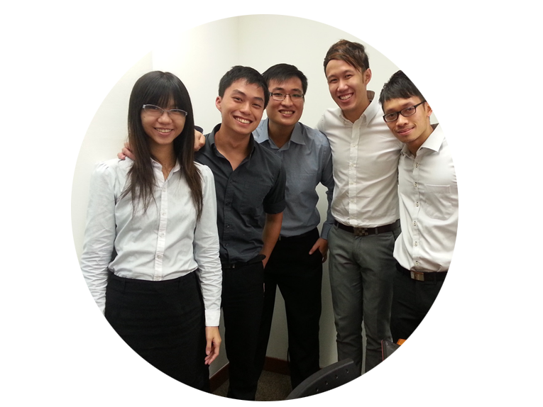
Interesting Facts About Our Team Members !!!
Team Members:
Kevin Onggo
Kong Yu Ning
Nicholas Lee Cheun Qing
Nyein Su Aye
Zachery Pang Zi Qi

Slide 33
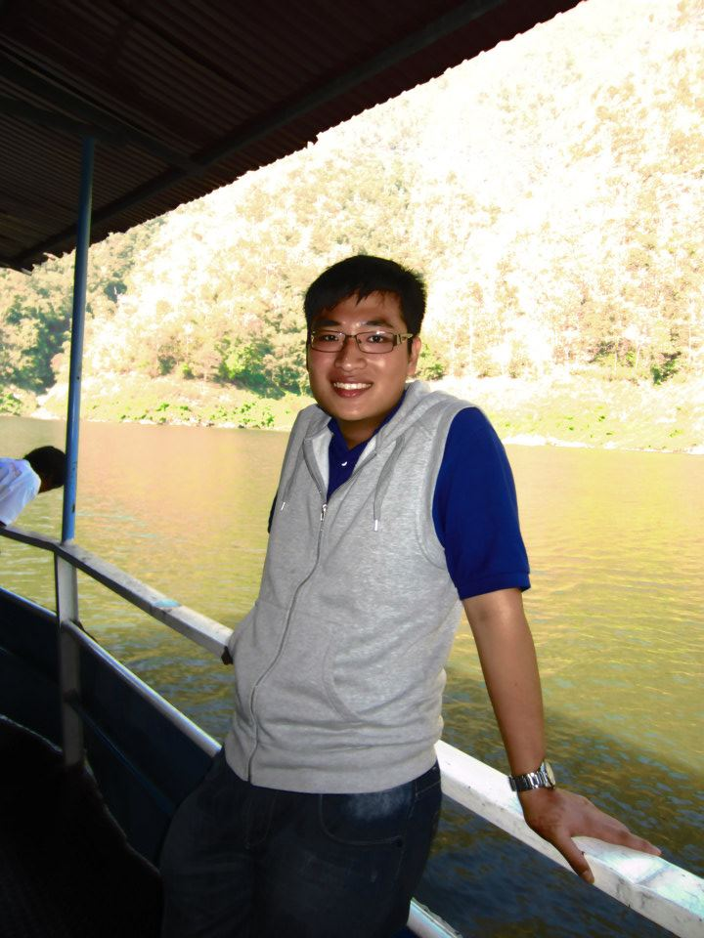
Kevin Onggo
Likes to say that he is lazy!

Slide 34

Kong Yu Ning
Always complain while doing or not doing work!

Slide 35
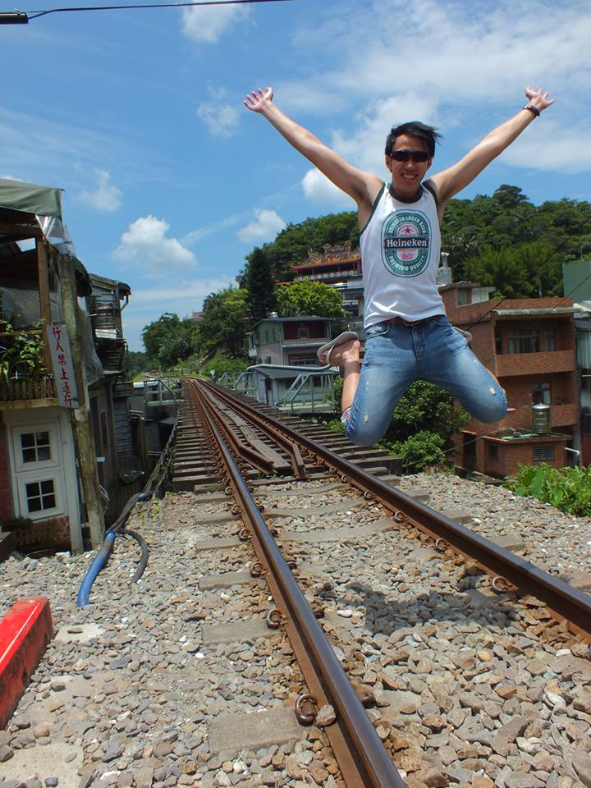
Nicholas Lee
Is tremendously proud of his “sexy” legs

Slide 36

Nyein Su Aye
Using a SUPER SLOWWW Mac

Slide 37
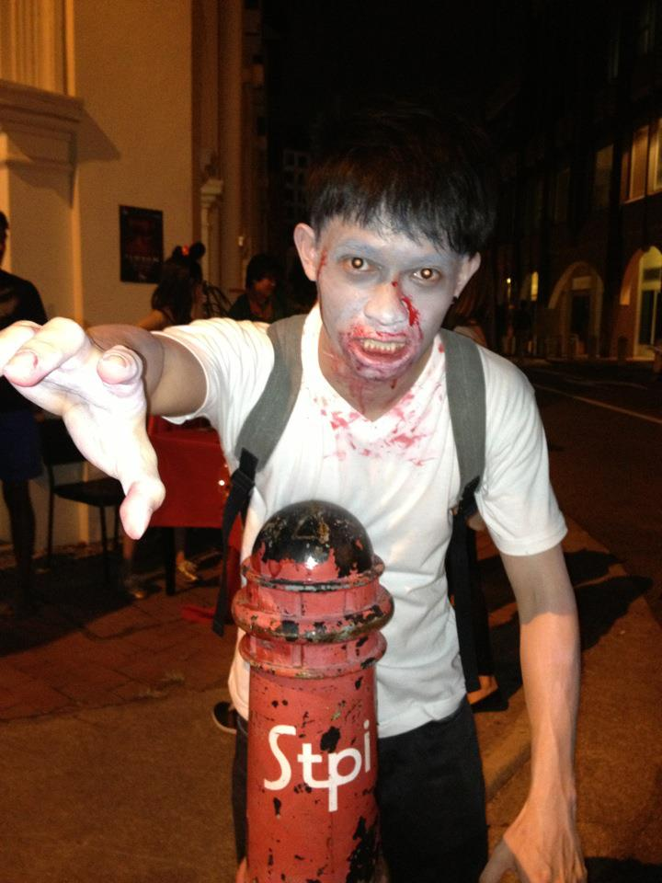
Zachery Pang
Eats one whole roast chicken for meals

Slide 38
The End

